Slide 1

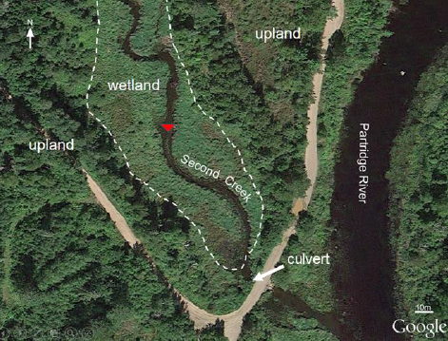
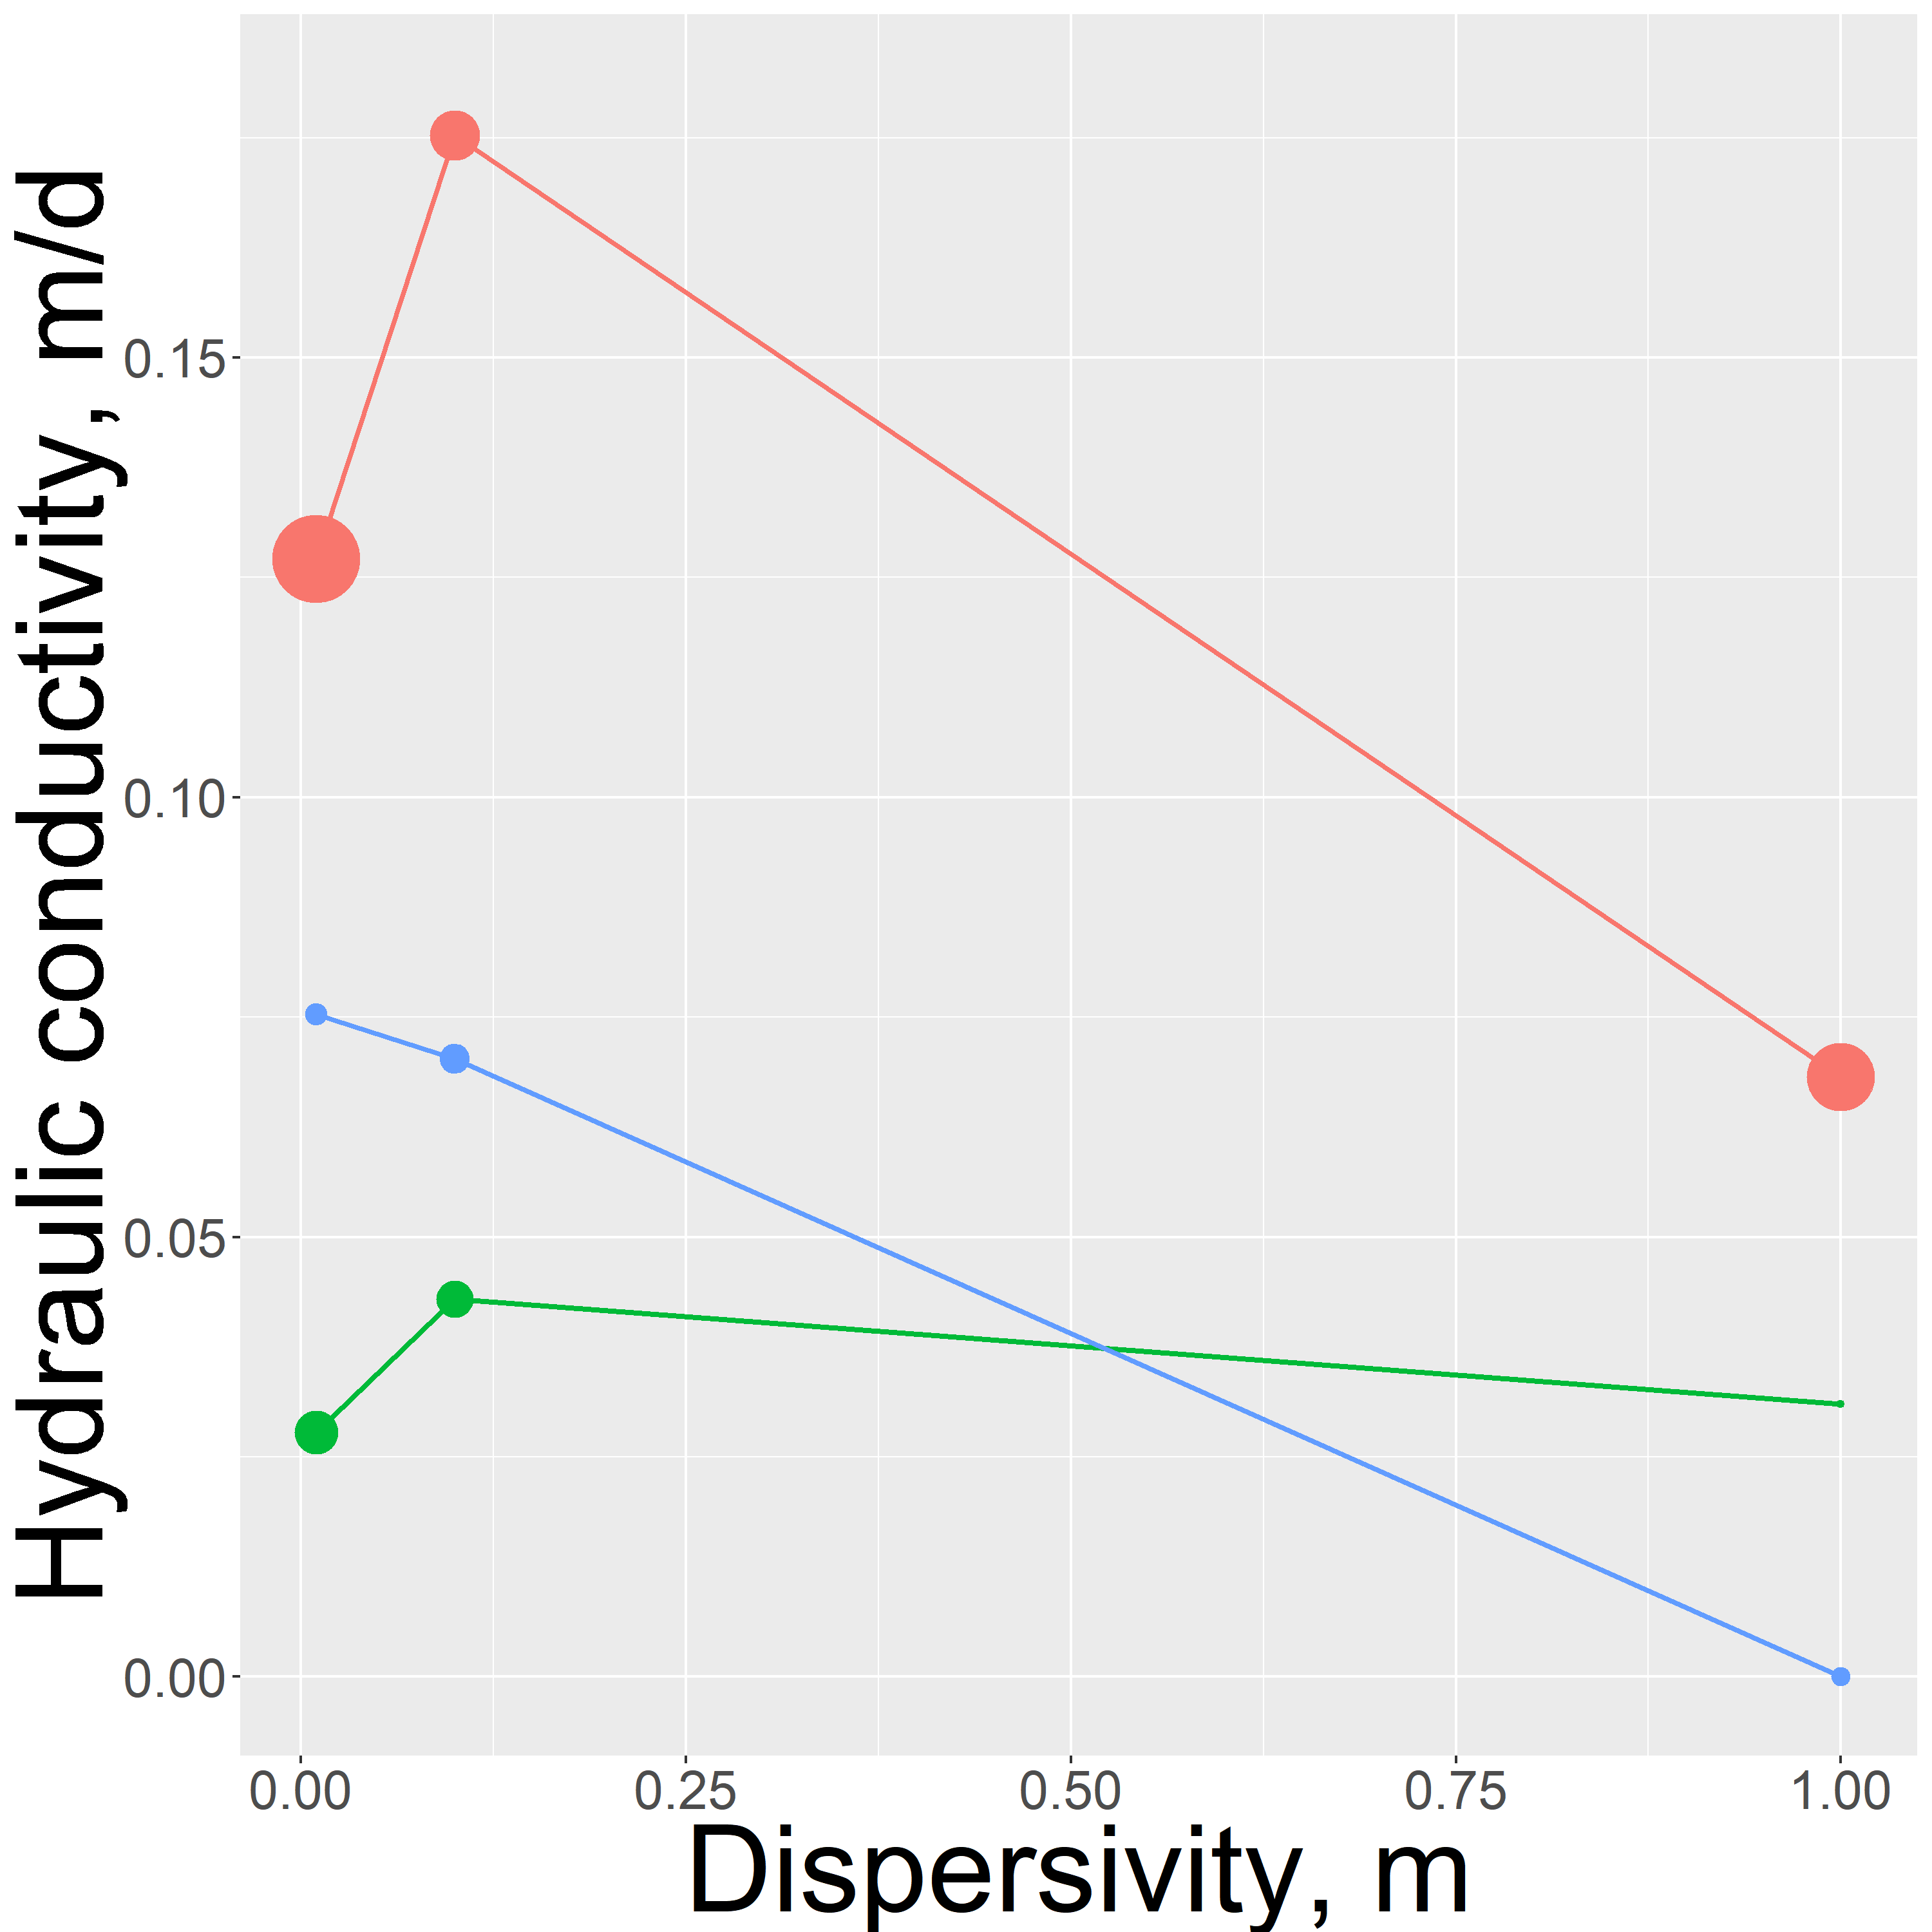
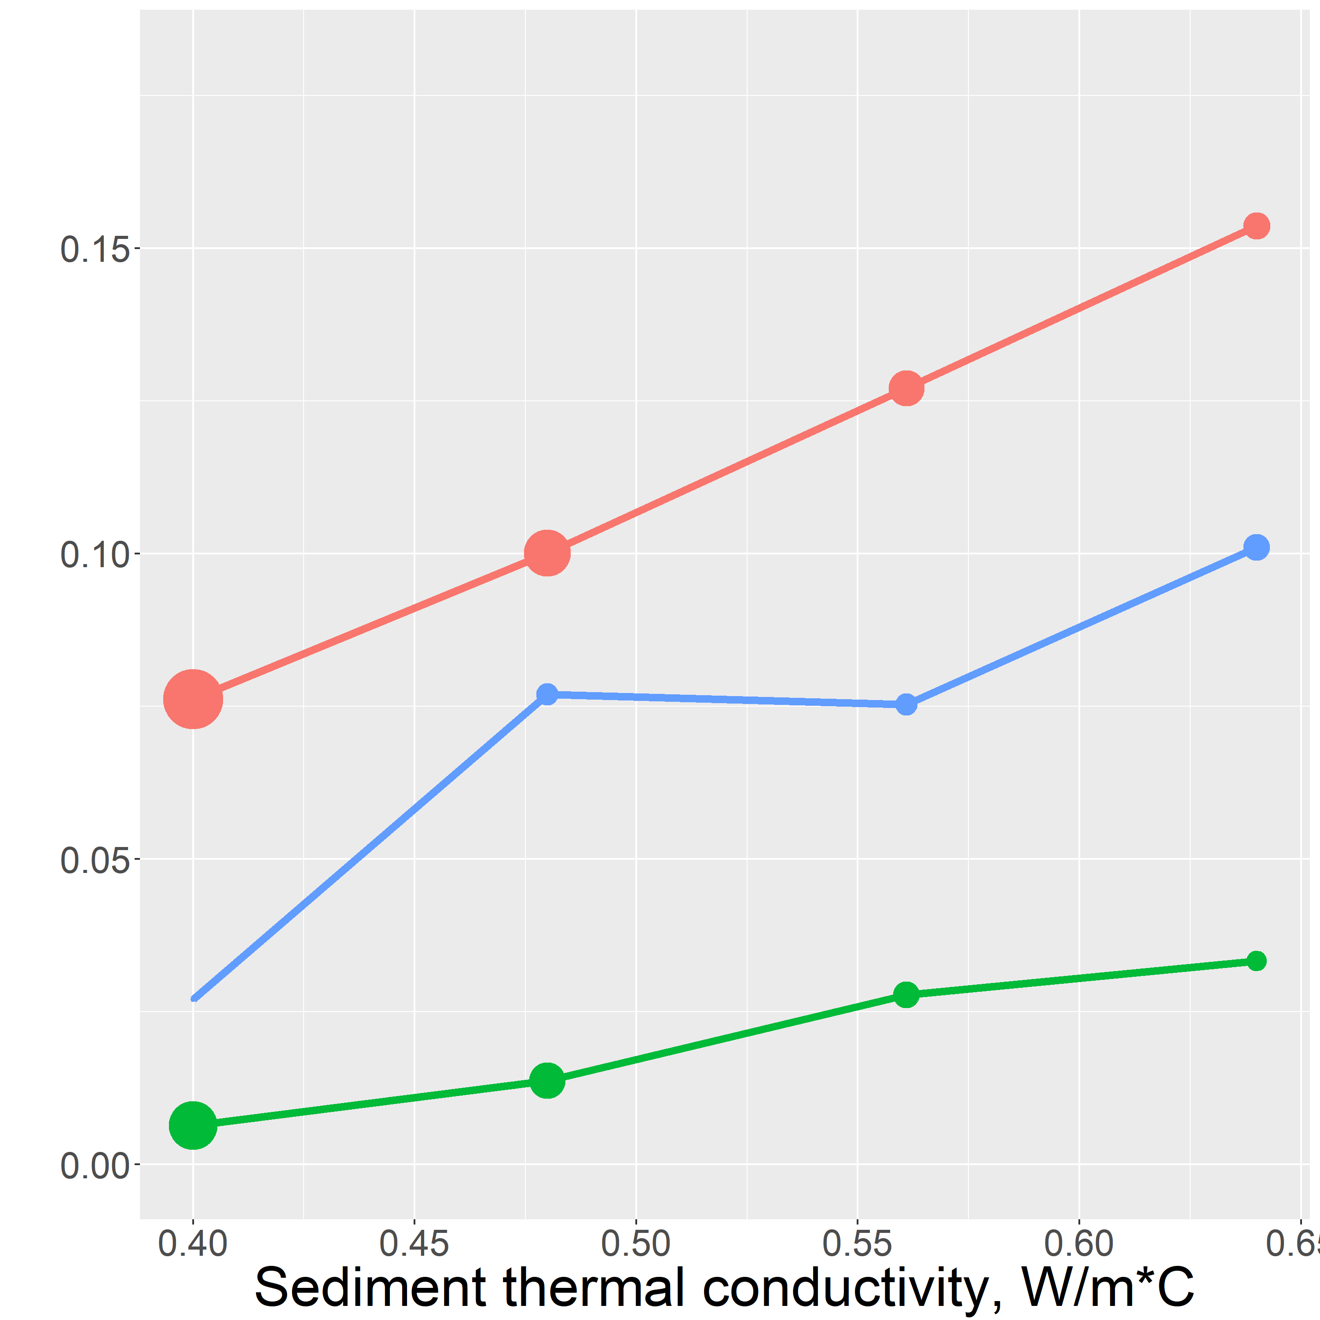
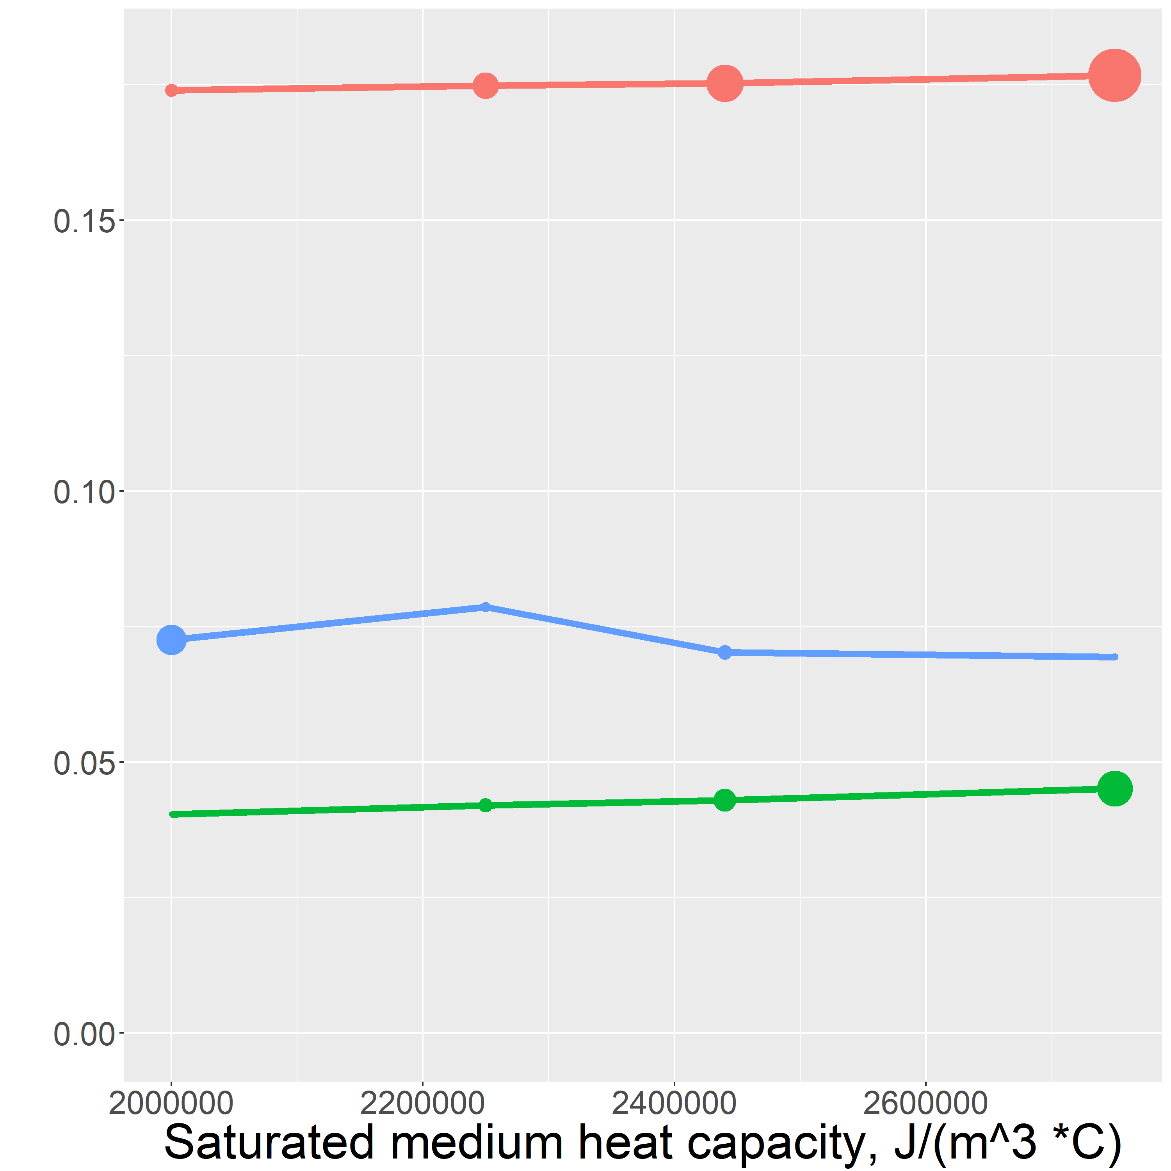
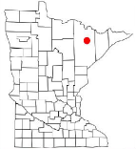
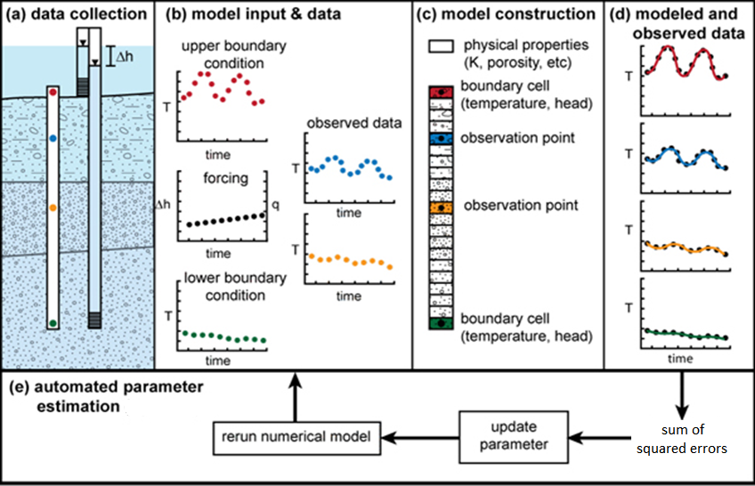
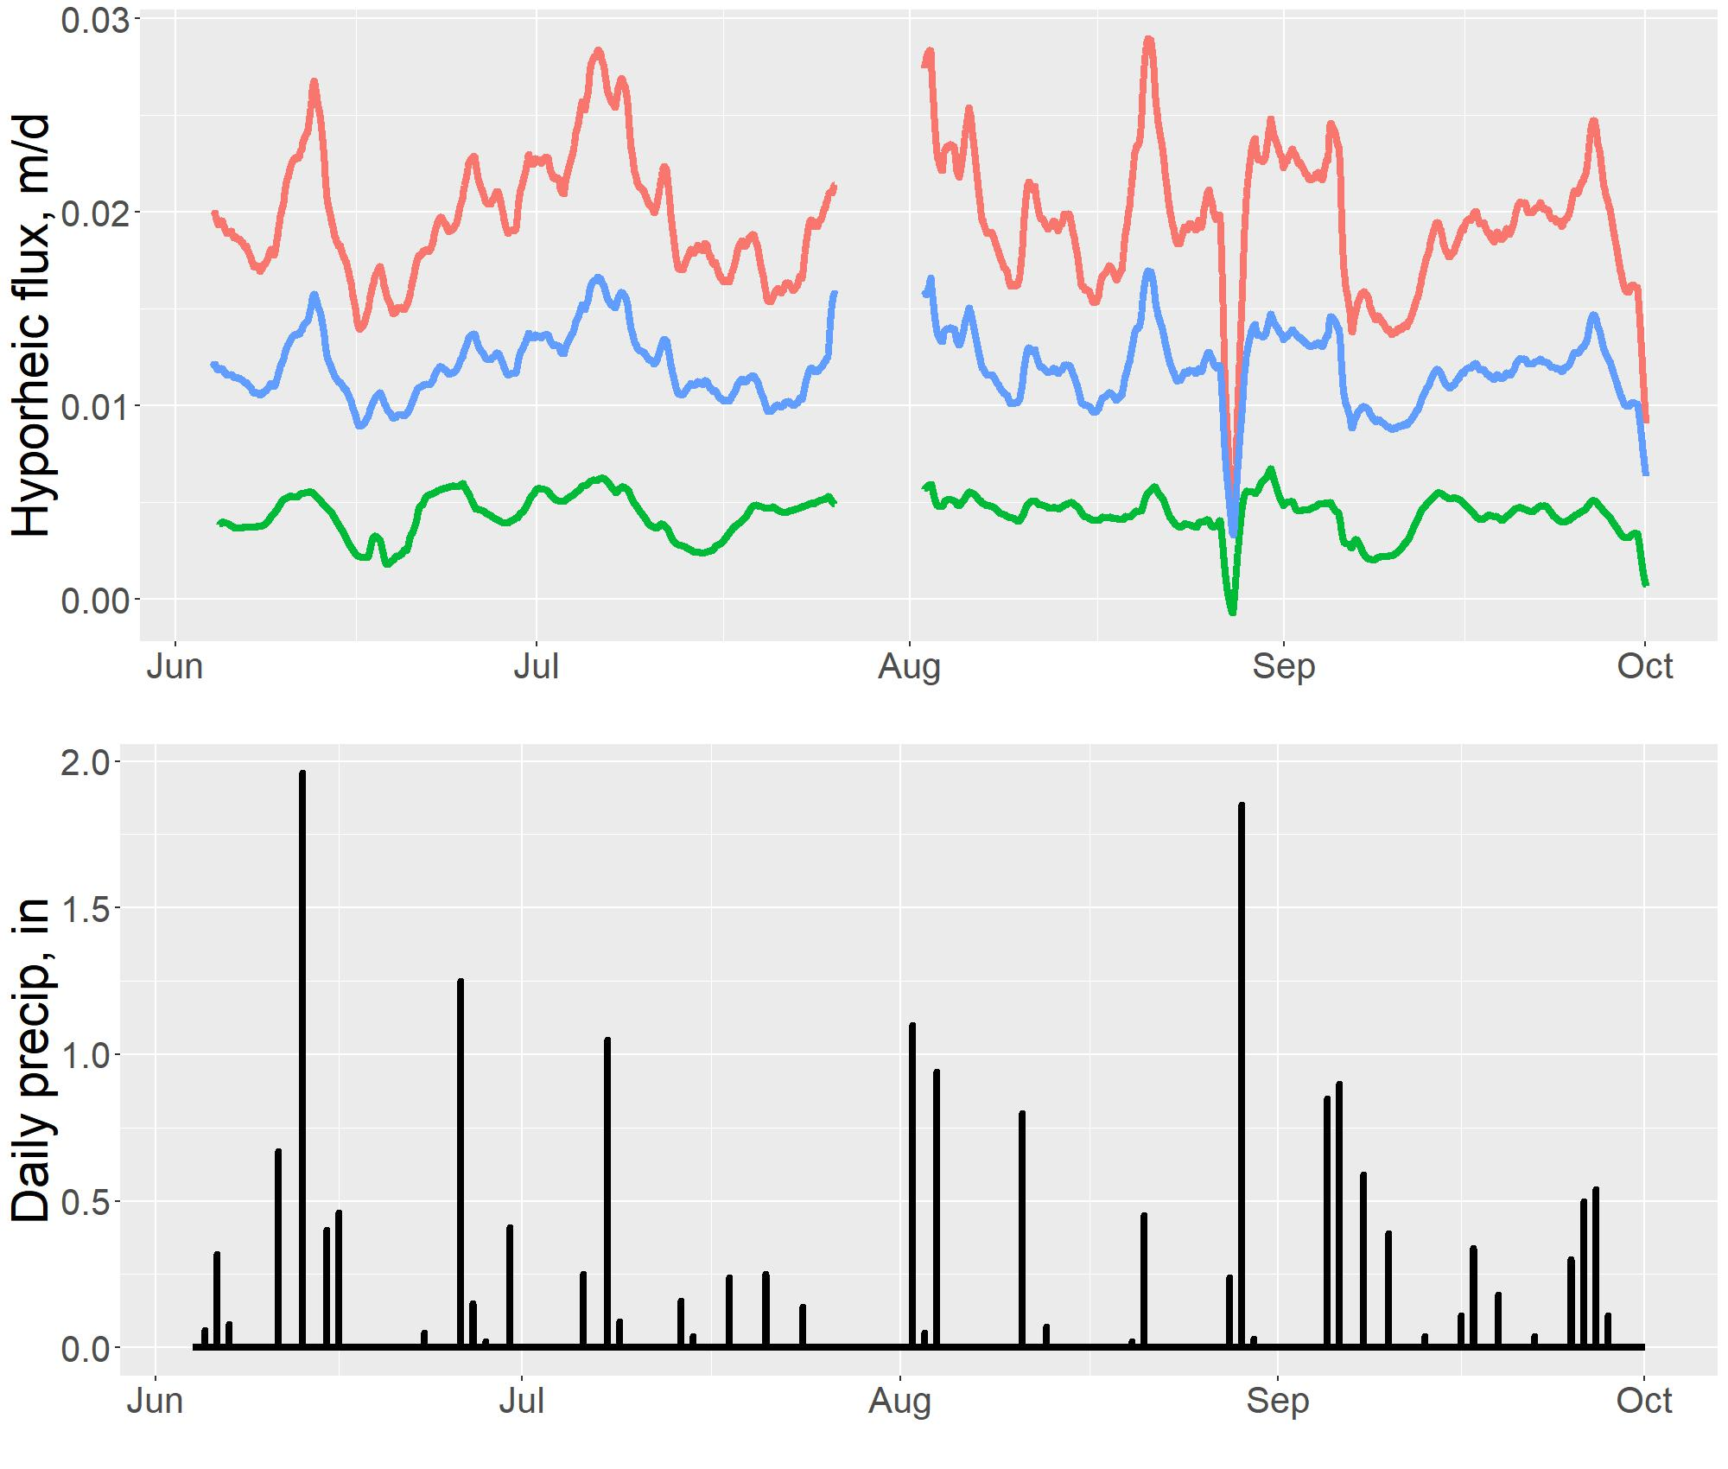
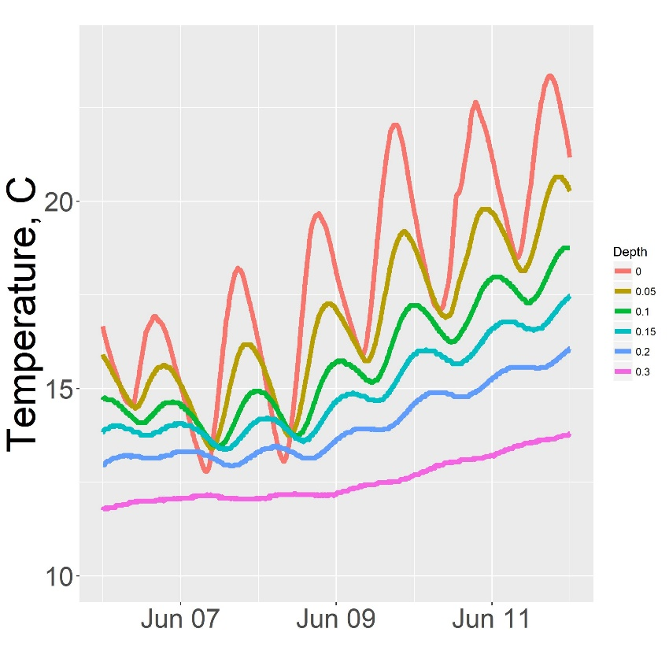
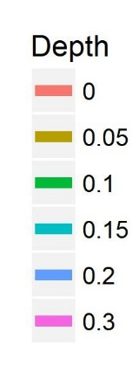
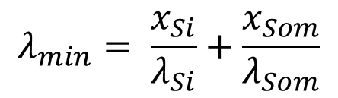

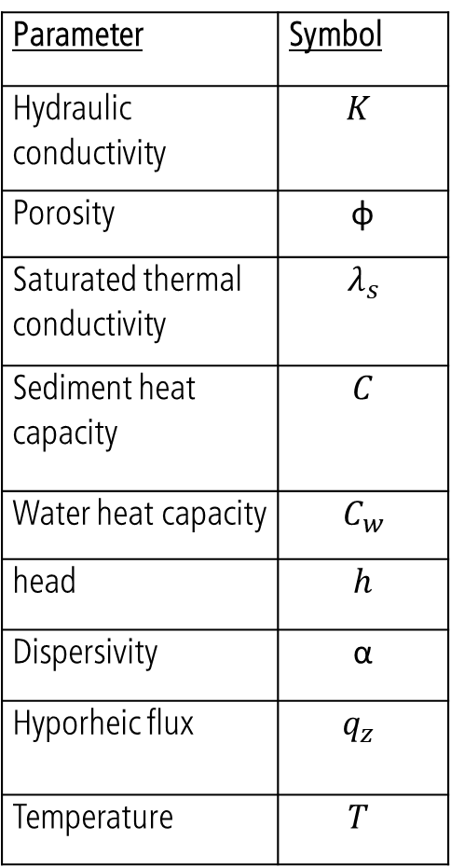


Quantifying Surface Water-Groundwater Exchange Using Temperature Profile Inverse modeling in a Riparian Wetland
number
Jack Lange, G.-H. Crystal Ng, Amanda R. Yourd, Chad Sandell , Andrew D Wickert
Dept. of Earth Sciences, University of Minnesota Twin-Cities
Introduction
Sediment characterization
Model fit and sensitivity analysis
Motivation: understand how mining derived sulfate affects biogeochemical cycling in first order streams on Minnesota’s iron range. The geochemical gradient is controlled by surface water-groundwater exchange (hyporheic flux) [Hayashi & Rosenberry 2002; Kurtz et al. 2007]
*Smaller marker indicates higher relative goodness of fit
Stream
Channel
Inverse model result
Wetland
Stream
Channel
Model failure
Value estimated from sediment characterization
[Yourd, 2017]
[Yourd, 2017]
Inverse model input parameters
Goal: quantify hyporheic flux at a mining impacted stream using inverse temperature profile modeling
Site: Second Creek is a riparian wetland located in Minnesota’s Iron Range
Thermal properties of the streambed and wetland sediment are required for modeling the temperature profile
Site sediment is characterized by high organic content, low dry bulk density, high porosity [Mybro, 2013]
Measured dry bulk density from [Mybro, 2013] used to estimate the fraction of silicate and soil organic matter
80-90% SOM, 10-20% silicate
Thermal conductivity and sediment heat capacity constrained by computing upper and lower bounds based on [Farouki,1961]
Dispersivity estimated from the range provided in [Zheng & Bennet, 1995]
Models fit the observed profiles well with average error between 0.09 and 0.17 degrees C.
Input parameter values were chosen to minimize model misfit.
Sensitivity testing matched intuition for dispersivity and thermal conductivity:
At high dispersivity, low upward flux is required and dispersity is the dominant mode of heat transport.
As thermal conductivity increases, larger upward flux Is required to counteract downward heat diffusion
Saturated heat capacity is relatively insensitive compared to site variability
Methods
Hydraulic conductivity is estimated by reducing the residual between an observed temperature profile and a modeled profile
Forward model governing equation
$${(λ}_{s}+q_{z}αC_{w})\frac{∂^{2}T}{∂t^{2}}−q_{z}C_{w}\frac{∂T}{∂z}=\frac{∂T}{∂t}(φC_{w}+(1−φ)C_{s})$$
$$q_{z}= −K\frac{dh}{dz}$$
$$λ_{min}= \frac{x_{Si}}{λ_{Si}}+\frac{x_{Som}}{λ_{Som}}$$
$$λ_{max}=x_{Si}λ_{Si} + x_{Som}λ_{Som}$$
Conclusions
Estimating K by fitting model to observations using 1DTempPro
[Healy, R.W., and A.D. Ronan. 1996]
Flux in the hyporheic zone is consistently upward throughout the summer so groundwater influences geochemistry in the streambed
Flux is spatially variable due to sediment heterogeneity
The lowest magnitude of flux occurs in the stream channel rather than the wetland.
The influence of precipitation on hyporheic flux is seasonally dependent
[Koch et al. 2015]
Parameter | Symbol
Hydraulic conductivity | $$K$$
Porosity | φ
Saturated thermal conductivity | $$λ_{s}$$
Sediment heat capacity | $$C$$
Water heat capacity | $$C_{w}$$
head | $$h$$
Dispersivity | α
Hyporheic flux | $$q_{z}$$
Temperature | $$T$$
Results
Location | Hydraulic conductivity, m/d
West wetland | 0.07
Stream west | 0.04
Stream center | 0.18
Future work
Center Streambed
Similar data with higher spatial resolution, and longer collection time (May–October) was collected in 2017
2017 data includes a long term flux reversal and could improve heterogeneity resolution
2018 field campaign potential: unique parameterization based on sediment collected at each probe location
Positive is upward flux
West Streambed
[Modified, Koch et al. 2015]
west streambed
Data collection
Three temperature probes were collocated with piezometers across the site
Pressure and temperature were measured at 15 minute intervals to capture diurnal variability over the summer
Data was collected using low cost, open source data loggers developed in house [Wickert, 2014]
Sample west streambed temperature data
Embarrass, MN
weather station
References
Farouki, O., 1961. Thermal properties of soils. United States Army Corps of Engineers Cold Regions Research and Engineering Laboratory.; Hayashi, M. & Rosenberry, D.O., 2002. Effects of Groundwater Exchange on the Hydrology and Ecology on Surface Water. Groundwater.; Healy, R.W., and A.D. Ronan. 1996. Documentation of computer program VS2DH for simulation of energy transport in variably saturated porous media – modification of the U.S. Geological Survey’s computer program VS2DT. U.S. Geological Survey Water-Resources Investigations Report.; Koch et al. 2015., 1DTempPro V2: New Features for Inferring Groundwater/Surface-Water Exchange, Groundwater.; Kurtz, A.M. et al., 2007. The importance of subsurface geology for water source and vegetation communities in Cherokee Marsh, Wisconsin. Wetlands.; Mybro, A., 2013. Wild Rice Sulfate Standard Field Surveys 2011, 2012, 2013: Final Report. University of Minnesota.; Yourd, A., 2017. Using reactive transport modeling to link hydrologic flux and root zone geochemistry at Second Creek, a sulfate enriched wild rice stream in northeastern Minnesota, Masters Thesis, University of Minnesota.; Wickert, A 2014. The Alog: inexpensive, Open Source, Automated Data Collection In the Field. The Bulletin of the Ecological Society of America Zheng, C. & Bennett, G., 1995. Applied Contaminant Transport Modeling . John Wiley & Sons.

